Slide 1

Final Public Meeting
February 15, 2018
Notes:
The Village of Oswego welcomes you to this public meeting for the Wolfs Crossing Corridor study.
Tonight‘s forum is a public meeting open house. It is the final step in the preliminary engineering process for this project.

Slide 2


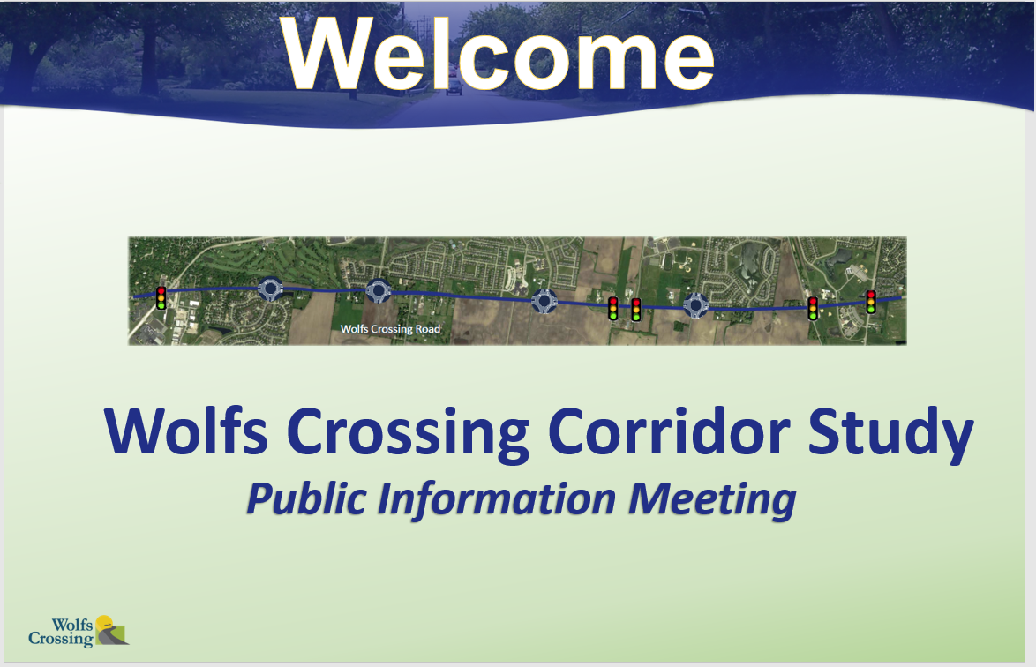
Tonight’s Meeting
Watch the presentation
Meet with the team
Ask questions
Record your comments
Notes:
The purpose of tonight’s event is to conduct the official public meeting for this project, which is required under the National Environmental Policy Act, or NEPA. You may have attended other public or stakeholder meetings and provided your feedback on alternatives and plans along the way. Those were held because the Village of Oswego truly wants your participation and feedback on this project, but were not required as a part of NEPA.
Tonight we will formally present the preferred alternative and request your feedback on our proposed plan.
The format of tonight‘s meeting is as follows:
(click) You will hear about the project in this narrated presentation.
(click) After the presentation, you can proceed into the exhibit area where you can speak with members of our project team. The team includes Village of Oswego representatives, as well as representatives from our design consultant, who are ready to answer questions that you may have about the project.
(click) We invite you to ask questions so you can fully learn about the plan and how it may impact you.
(click) Please note that if you want your comments to become part of the official public record for this project, it is important that you (click) write them down. Forms are available in the comment area for your use

Slide 3
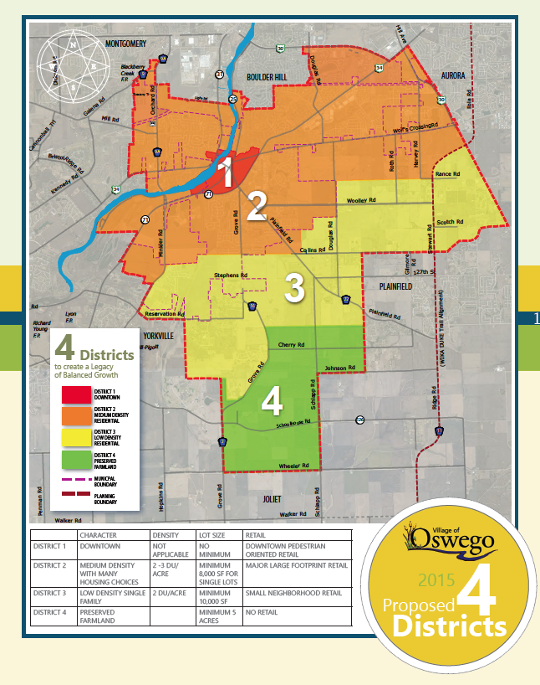
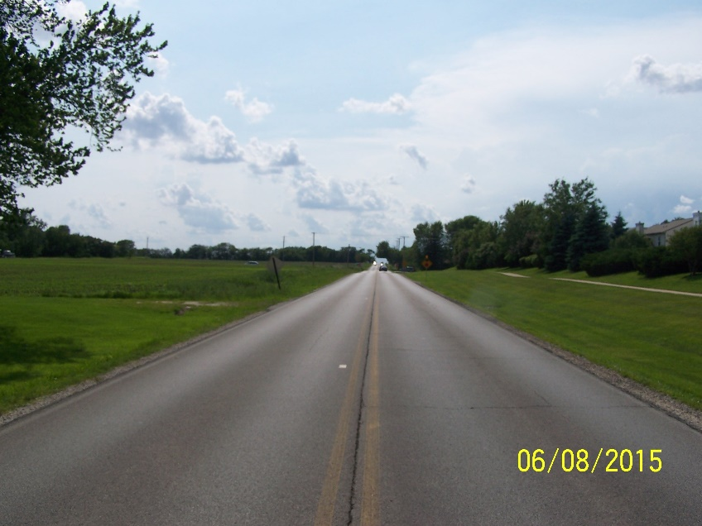
The Wolfs Crossing Project
Wolfs Crossing Road
1
2
3
4
Wolfs Crossing Road
Notes:
The Village of Oswego is concluding an 18 month long study of Wolfs Crossing Road to determine future needs for this important east-west corridor in the Village. Wolfs Crossing (click) is located in the northern part of the Village, in the area designated as District 2 (click) in the Village’s Comprehensive Plan. In a effort to ensure balanced growth, the Village has identified District 2 as the medium density residential growth part of the Village. Thus, Wolf’s Crossing is in the center of this anticipated growth.
(Click) The road is currently one lane in each direction. (Click) Wolfs Crossing continues to see traffic growth from both local traffic as well as the region. In certain locations along the corridor, it is already starting to see signs of traffic congestion and resulting increased crash rates. Therefore, the Village initiated this study now to ensure that there is a proper plan in place to address capacity and safety as they become a need.

Slide 4
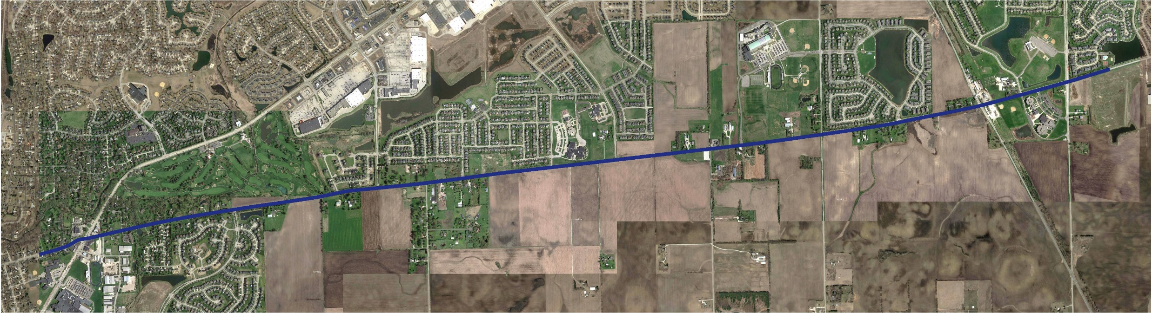
The Wolfs Crossing Project
4.4 miles
PRESCOTT
MILL
EOLA RD
CHURCHILL ELEMENTARY
& PLANK JRHS
OSWEGO EAST
HIGH SCHOOL
WOLFS CROSSING ELEMENTARY
& BEDNARCIK JRHS
DOUGLAS RD
CHURCHILL
CLUB
WOLFS CROSSING RD
HARVEY RD
HEGGS RD
ROUTE 34
ROTH RD
LINCOLN HIGHWAY (ROUTE 30)
SOUTHBURY
DOUGLAS RD
ROUTE 71
Notes:
The project study limits extend from (click) Heggs/Eola Road on the east to (click) IL Route 34 on the west. The corridor spans (click) 4.4 miles from the City of Aurora through the Village of Oswego and Oswego Township. The corridor includes nine intersections that currently meet the manual of uniform traffic control devices (otherwise known as the MUTCD) warrants to install intersection control devices, meaning that signals or other improvements are justified today under current traffic. Two of the intersections (click) are under the jurisdiction of the Illinois Department of Transportation and one (click) is under the jurisdiction of the City of Aurora. The remaining seven intersections are under the jurisdiction of the village of Oswego. The plan for how and when these intersection improvements should be implemented is the focus of this study

Slide 5
Purpose and Need for the Project
Notes:
The Village is completing this study in compliance with the federal highway administration guidelines and the national environmental policy act (NEPA) to ensure that the project remains federally eligible for funding opportunities. This project is a major undertaking for the Village, and securing of federal funding will be a critical component of building this project.
The first step in the federal process is to assess the purpose and need for the project.

Slide 6
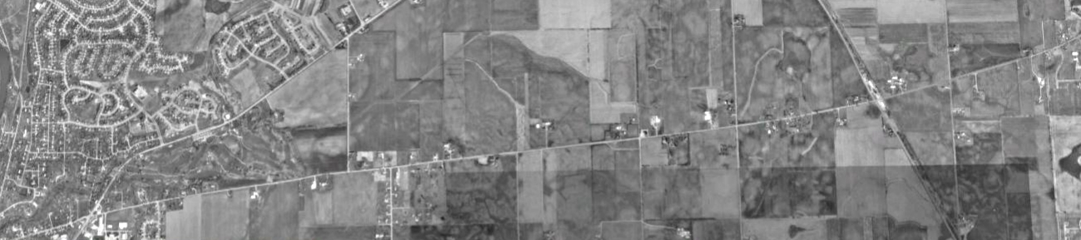

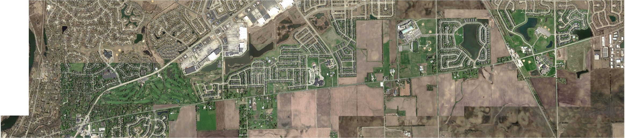
Corridor History
1994
ROUTE 34
WOLFS CROSSING RD
LINCOLN HIGHWAY (ROUTE 30)
2014
ROUTE 34
WOLFS CROSSING RD
LINCOLN HIGHWAY (ROUTE 30)
Notes:
To assess the potential need for this project, it is important to quantify the safety and capacity of the roadway.
To begin this exercise, it is important to understand the history of this corridor.
For long time Oswego residents, you may remember the open farm lands and fields on either side of Wolf’s Crossing, as shown on this corridor map from 1994. (click) The area in blue illustrates the undeveloped areas, which are now fully developed parcels along the corridor as of 2014.

Slide 7

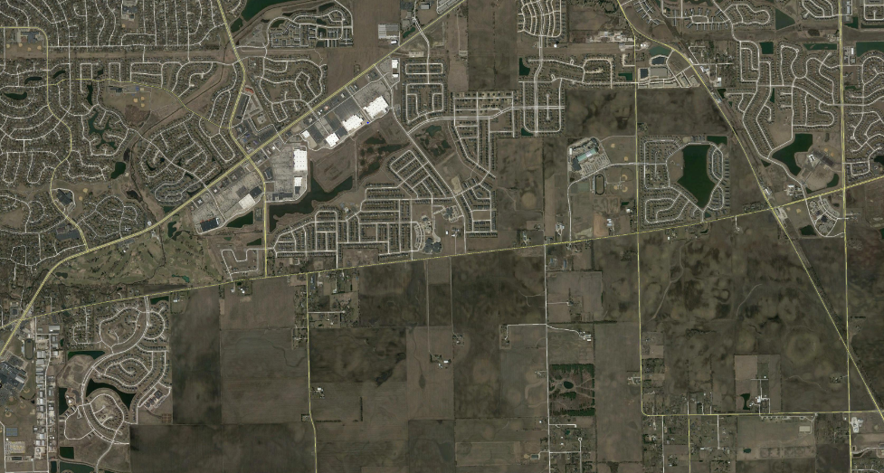
Evaluate – 5 Lanes: When and Where
Potential Development
Eola Road
Route 34
N
Douglas Road
Planned Development
Wolfs Crossing
Fifth Street
Harvey Road
Lincoln Highway (Route 30)
Potential Development
Roth Road
Estimated boundary of development influence on Wolfs Crossing
Notes:
The green lines shown on this graphic (click) illustrate those areas of land that contribute or will contribute traffic to Wolfs Crossing. (click) the area in transparent blue shows those areas that developed in the period from 1994 to 2014.
The economy incurred a significant downturn during that 20 year period, resulting in a pause in development along the corridor. However, it is expected that those vacant lands (click) (shown in solid blue) will someday be developed. Wolfs Crossing is a beautiful corridor, and the Village’s comprehensive plan shows these parcels developing as almost all residential housing.

Slide 8
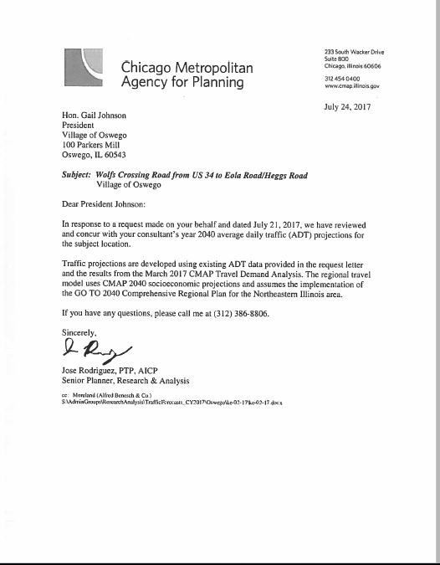

Traffic: Year 2040 Forecast
Anticipated traffic due to regional growth
Anticipated traffic due to adjacent development
CONCURRED
Year 2040 Forecasted Traffic
Existing traffic
Notes:
Studying the projected traffic on the corridor requires looking at several different contributors. We chose the year 2040 as the planning horizon for this project, so it was necessary to develop 2040 traffic projections for the corridor. The existing traffic has been counted by electronic video counters along the corridor to establish our baseline. (click) in the previous slide we spoke about the anticipated traffic due to the adjacent developments. These traffic estimates are computed by determining the projected trips based on the housing density for each available parcel (click) and then adding on the anticipated traffic due to the regional growth of the area. The existing and projected traffic are added together to create the year 2040 forecasted traffic estimate.
These estimates were calculated by the project team and then submitted for review by the Chicago Metropolitan Agency for Planning (CMAP). CMAP is the agency responsible for projecting traffic growth for the Chicago region. CMAP concurred with these projections in July 2017

Slide 9
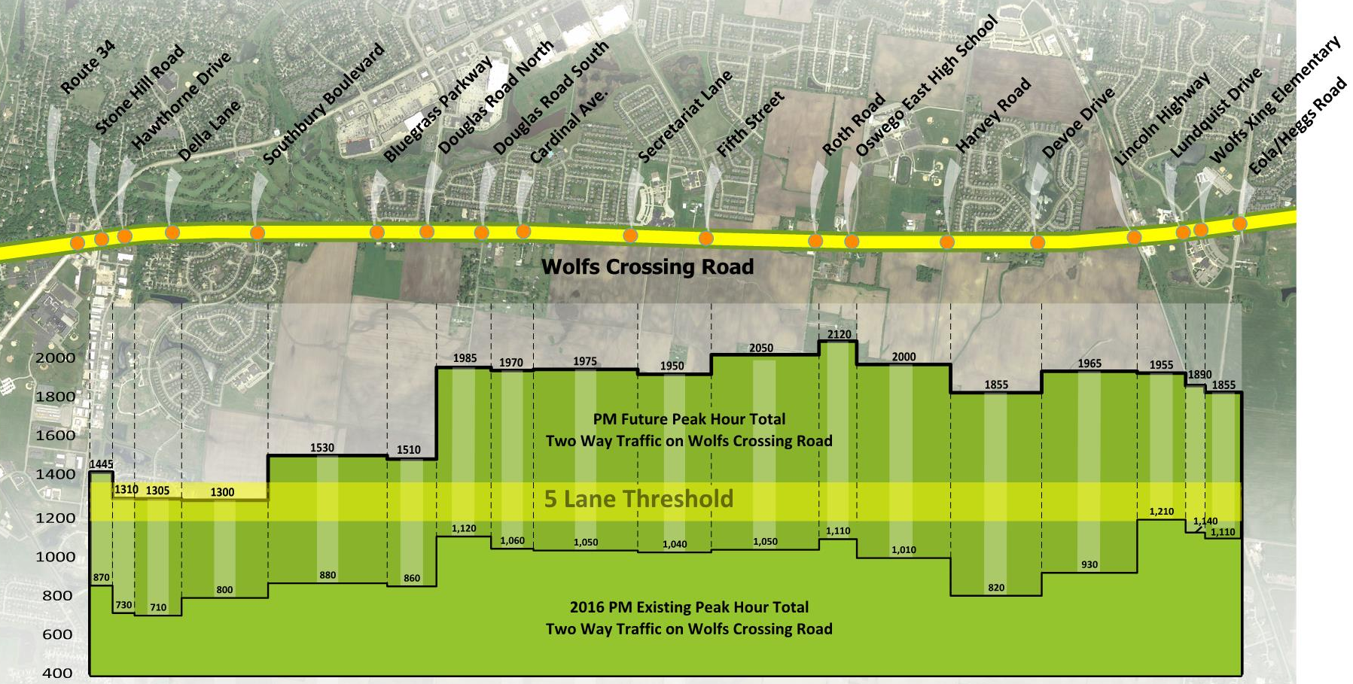
Traffic: How many lanes?
Notes:
(animation needs to be added for the bars)
Once the traffic projections were complete, they were applied to the corridor to determine how many lanes will be needed to provide adequate lane capacity along the route.
The yellow line illustrates the roadway centerline. (click) The intersections are shown as orange circles and labeled above the yellow line.
The green bars below the roadway line show the existing peak hour traffic as per the field counts conducted in late 2016. The peak hour traffic on Wolfs Crossing currently occurs during the weekday afternoon rush. As you can see, traffic is not uniform across the corridor, as some segments experience more traffic than others. The current peak traffic levels occur in the center of the Corridor and at the east end. So how many lanes does Wolfs Crossing need?
(click) A single travel lane can typically support traffic in the range of 1200 to 1350 vehicles per hour. Past that point, congestion occurs along the route and crash rates begin to increase. The yellow bar illustrates the approximate threshold at which Wolfs Crossing will begin to need an additional lane in each direction to accommodate traffic. As can been seen, all of the existing traffic is under that threshold today, although a few segments are getting close to the threshold.
(click) Look at what happens when we add projected 2040 traffic to the graphic. All of the corridor east from Southbury Boulevard significantly exceeds the threshold. Therefore, at some point in the next 20 years, the majority of the corridor will require two lanes in each direction with an additional turn lane (ie 5 lane section) to ensure adequate capacity and safety on Wolfs Crossing. The challenge for the Village is to anticipate this growth and have the adequate lanes in place in time before this threshold is substantially exceeded.

Slide 10
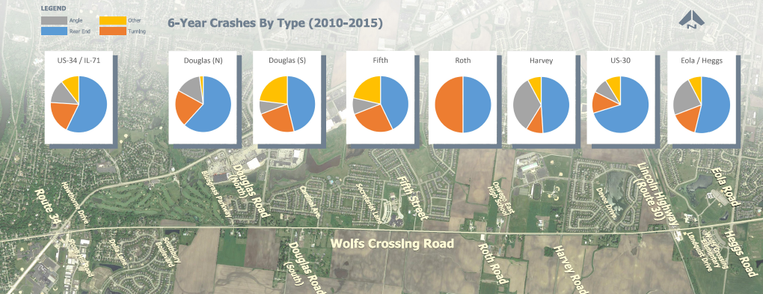
Crashes
US34/71
Douglas N
Douglas S
Fifth
Roth
Harvey
US 30
Eola/Heggs
96
47
13
42
6
51
57
26
Notes:
The other element to examine when considering the purpose and need for a project is its safety record, assessed by the number of crashes on the corridor. The team gathered crash data for the corridor for the period 2010 to 2016, and as is illustrated, crashes on wolfs crossing are significant.
The white boxes illustrate the total crashes incurred at each intersection during this time period. The two IDOT intersections, (click) US 34 and US 30, exhibit the highest number of crashes. However they also have substantially greater traffic as they are a state route. (click) Of more significant consequence is the number of crashes on the local jurisdiction intersections of Douglas, North, Fifth and Harvey. Higher crash rates may indicate that these intersections are starting to experience capacity issues.
Another notable item on this graph is the large portion of these pie charts shown in light blue. (click) Light blue indicates the rear end collision rate. As congestion increases along a corridor, drivers can be surprised by the need to stop for congestion, driving up rear end crash rates.

Slide 11
Considering alternatives
Notes:
The next step in the planning process was to develop alternatives for consideration.

Slide 12
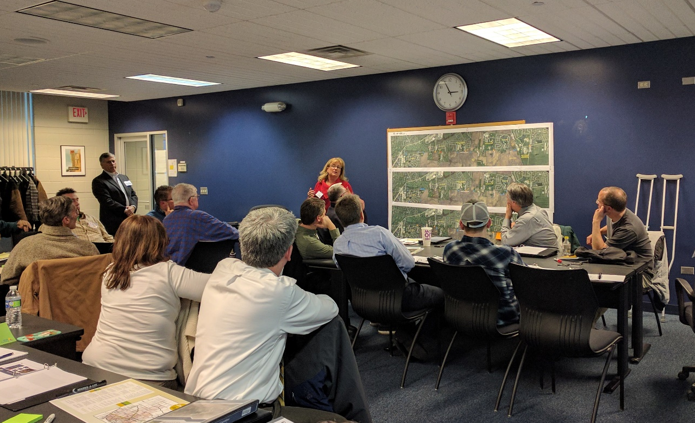
Corridor Advisory Team (WolfCAT)
1/11/2017
3/23/2017
9/28/2017
Who is the WolfCAT?
Representatives of School District 308 (3)
Representatives from IDOT (2)
Officials representing the Oswegoland Park District, Village of Oswego, Oswego Township, Oswego Chamber of Commerce, City of Aurora, Oswego Fire Protection District, Kendall County, and Will County (12)
Local business owners located on the corridor (8)
Residents located on the corridor (18)
Notes:
To help us develop and consider alternatives, the Village formed an advisory team for the corridor, known as the WolfCAT. The wolfcat team consisted of several stakeholders that play an important role along the corridor. These included (click) School District 308, (click) the Illinois Department of Transportation (IDOT), (click) the Oswegoland Park District, Kendall County and the City of Aurora as well as (click) property owners, residents, homeowners associations and businesses along the corridor. We invited any interested stakeholders to join the group at our first public meeting, and this resulted in a dynamic and engaged group. The Village of Oswego thanks all of the members of this vibrant group. They are an integral part of this project plan and their service to the Village on this important project is much appreciated..

Slide 13
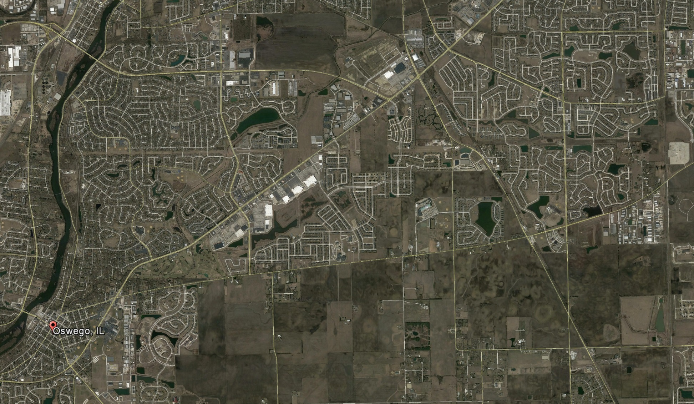
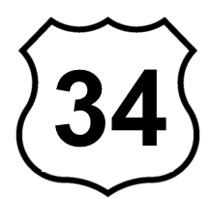
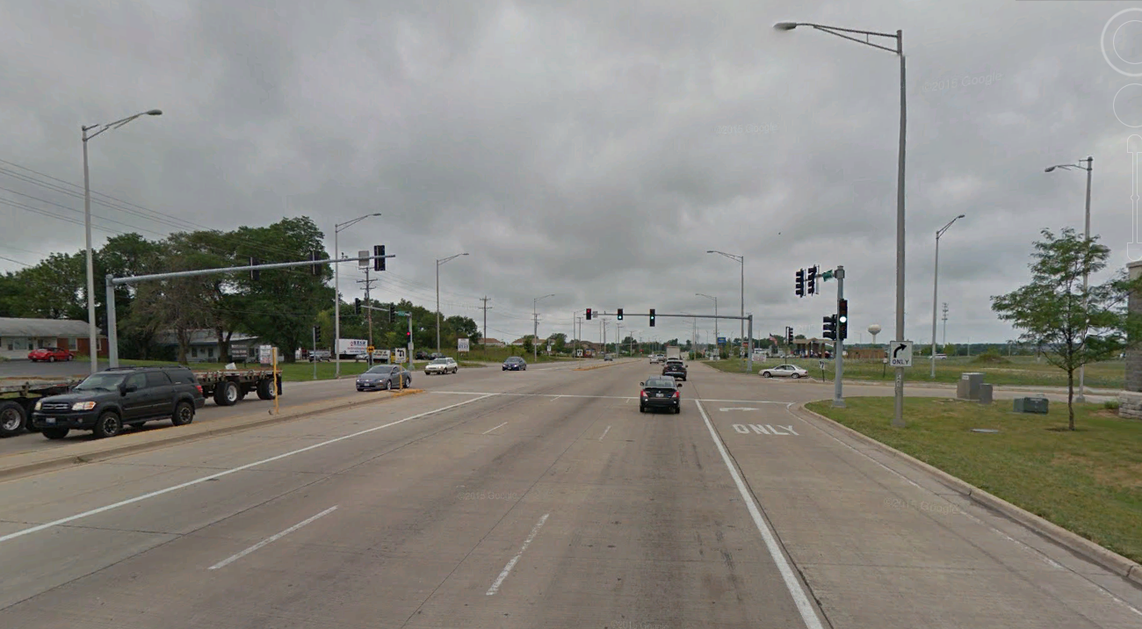
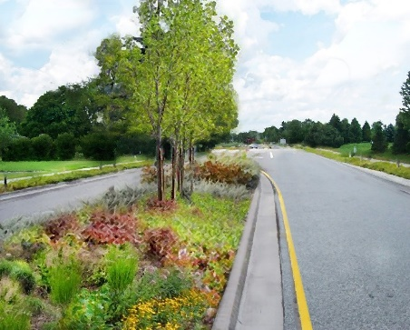
Character of the Corridor
Attract traffic:
State Route
N
Commercial corridor
Eola Road
Fox River
Wolfs Crossing
Residential corridor
Douglas Road
Lincoln Highway (Route 30)
Harvey Road
Roth Road
Fifth Street
Vision: Bold, Balanced, Bountiful
Notes:
The WolfCAT spent some time understanding the role that Wolfs Crossing plays in the Village’s overall transportation network and what the character of the roadway should be.
(click) Looking at the area in general, US 34 is a state route, functioning as a commercial corridor designed to attract traffic. It is a straight alignment, four lane roadway with turn lanes at multiple locations to access local businesses.
(click) In contrast, Wolfs Crossing is a residential corridor. Thus the WolfCAT chose to honor the Village’s vision of bold, balanced and bountiful for this project The corridor, when 5 lanes are needed, will include a vegetated median and native plantings to help maintain the pastoral nature of the roadway corridor.

Slide 14
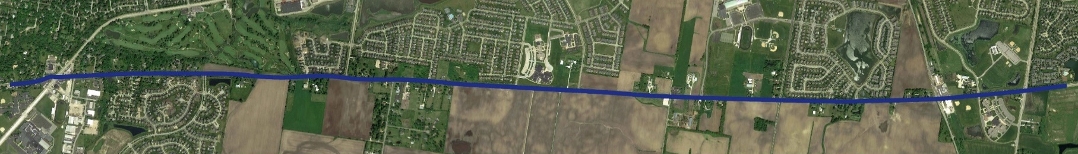



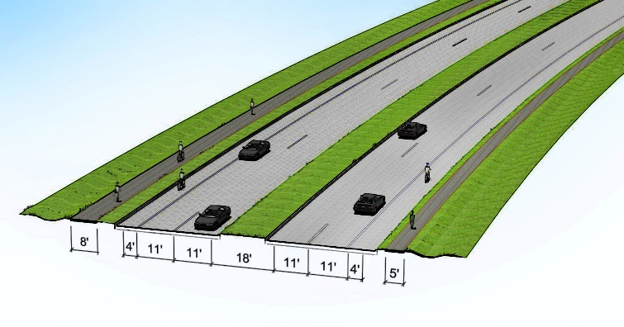
WolfCAT Accomplishments
Purpose (What are we trying to accomplish?)
Enhance safety
Reduce traffic congestion
Improve mobility and operations
Accommodate economic development
1
Formulated purpose and need statement
Need (Why are we studying this corridor?)
Crash history
Capacity analysis of existing traffic data
Projected future traffic growth
Existing mobility and operations (Multi-modal)
Address drainage inadequacies
Minimize environmental impacts
2
Recommended alignment
3
Recommended intersection types
4
Recommended cross section
Notes:
The corridor advisory team accomplished many tasks as a part of their work on this project.
(click 3 times) First they formulated a formal purpose and need statement, capturing all of the reasons that the project is needed
(click) They worked hard to develop a recommended alignment. The roadway centerline consists of a series of gentle curves to make the corridor feel more like a peaceful residential drive rather than a race down a commercial thoroughfare. (click) they learned about and recommended intersection types for each of the intersections along the Corridor and finally (click) they recommended a cross section which included two lanes in either direction with a landscaped median, shared use path on the north right of way and sidewalk on the south side

Slide 15

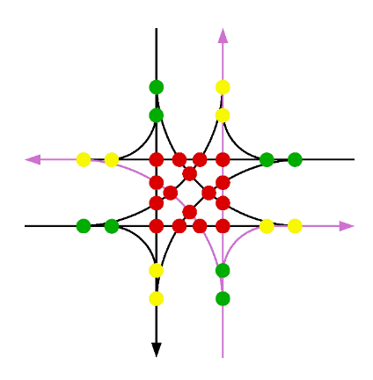


Traffic Signals vs. Roundabouts:
Crash Potential
Conflict Points
Crash Potential
A conflict point is a location where the travel paths of two different vehicles may collide
Assigns right-of-way
Tends to increase rear end crashes
5% - 45% overall reduction in crashes compared to an all-way stop*
Conventional Intersection
Roundabout
Reduces conflict points: conflicting vehicles only approach from one direction
Reduces severity of crashes by keeping vehicle speeds low 60% - 70% overall reduction in crashes compared to an all-way stop*
Conflict Type | Conventional Intersection | Roundabout
Diverge | 8 | 4
Merge | 8 | 4
Cross* | 16 | 0
Total | 32 | 8
*Source: FHWA Crash Modification
Factors Clearinghouse
*Crashes of this type are more severe
Notes:
In considering intersection options, the WolfCAT spent some time learning about the differences between stop signs, traffic signals and roundabouts. The difference in these intersection control types is not simply in just the look and feel, but rather in the benefits that they provide.
First, lets look at the differences in crash potential. (click) Traffic signals and stop signs function by assigning the right-of-way to each of the legs of the intersection (click) however signals and stop signs typically tend to increase rear end crashes, as vehicles are now approaching a stopped condition at the intersection. (click) Overall, traffic signals win out over stop signs, resulting in a reduction of crashes anywhere from 5 to 45%
(click) Roundabouts on the other hand, (click) physically reduce the number of possible conflict points between vehicles, as vehicles only approach from one direction and simply do not encounter each other. (click) Roundabouts result in reduced severity of crashes due to slower speeds when navigating the roundabout. (click) and so overall, roundabouts offer a reduction of 60 to 70% of the crashes compared to an all way stop
(click) The reason for the significant crash reduction is due to the reduction in potential points of conflict or conflict points. Conflict points are simply any locations where two vehicles could possibly run into each other in any given intersection. (click) The conventional intersection on the left shows all the different operational spots in an intersection (conflicts) that could possibly result in crashes. These are shown as green, yellow and red circles. (click) The roundabout graphic on the right shows the conflict locations in that configuration. (click) Looking at these in summary, in a conventional intersection there are 32 conflict points as compared to 8 in a roundabout. The severity of the crashes are shown as green, yellow and red. As can be noted, 16 of those conflict points in the conventional intersection are cross type conflicts (red) and tend to be more severe due to their angular nature and often higher speed.

Slide 16
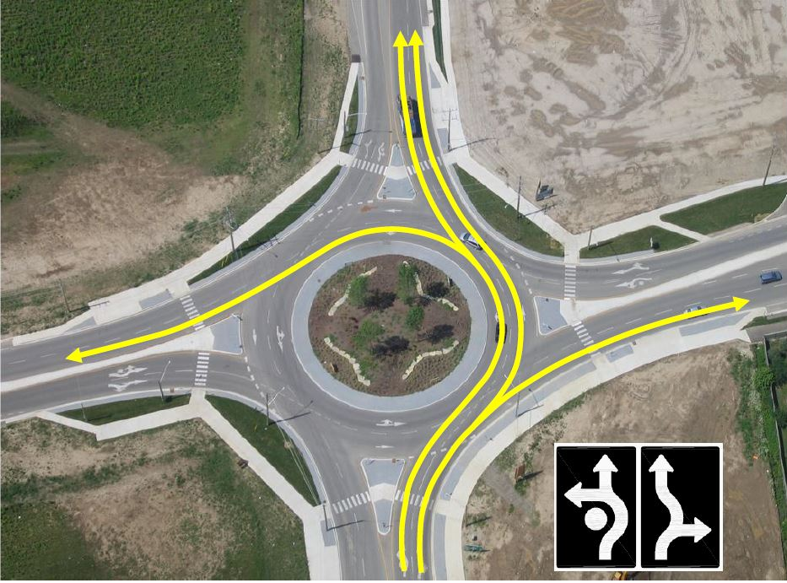

Conventional Intersections vs. Roundabouts
Traffic Operations
Operational comparison: Harvey Rd intersection
Conventional Intersection
All-Way Stop (2016)
76 seconds average delay
Conventional Intersection
Traffic Signal
(future year 2040)
23.9 seconds average delay
Roundabout
(future year 2040)
5.8 seconds average delay
Fewer Conflict Points
*Crashes of this type are more severe
Notes:
In addition to significantly reduced crash potential, roundabouts also offer improvements in traffic operations. Traffic engineers quantify the operation of an intersection by the delay that drivers experience while traveling through the intersection. Our project team looked at a roundabout at Harvey Road to compare the differences in how quickly traffic will travel around the intersection in the three different design scenarios. In a conventional all way stop sign controlled intersection today, traffic experiences 76 seconds of average delay (click) and will be even higher in 2040. If we install a traditional signal at this intersection, under 2040 traffic conditions the delays are reduced to 23.9 seconds (click) and with a roundabout we see even more improvement, reducing delays to just 5.8 seconds.

Slide 17
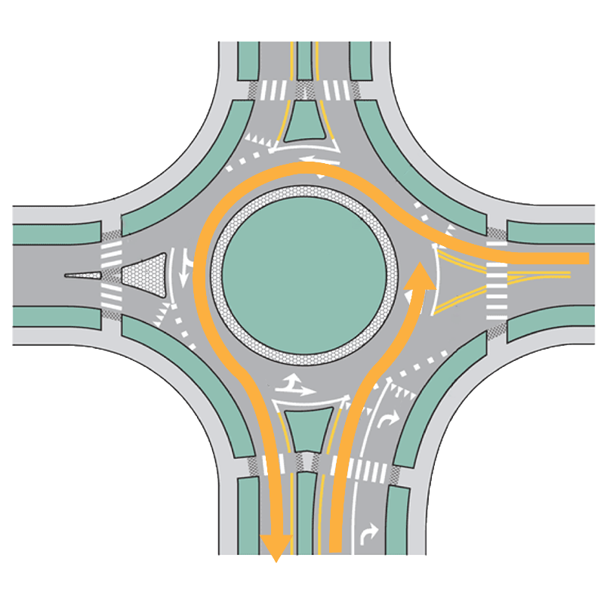


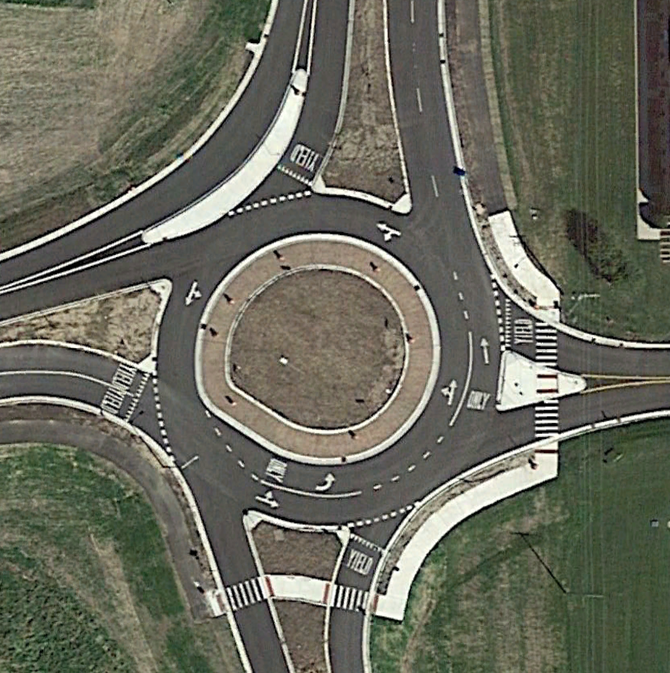
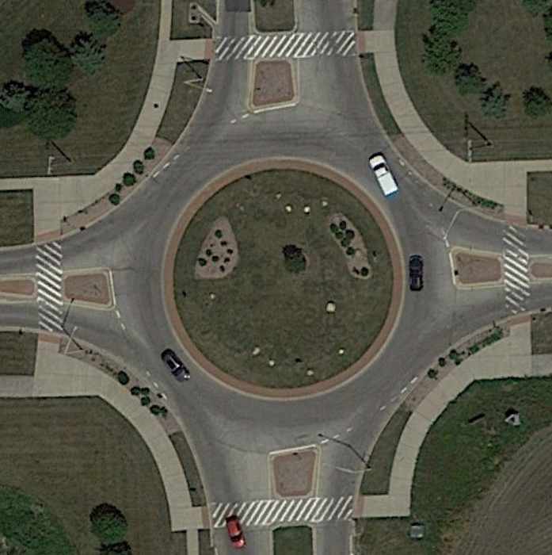
How does a roundabout work?
Nearby roundabouts you may be familiar with
Counterclockwise
circulation
Aurora: Sullivan Road and Highland Road
Sugar Grove: Dugan Road and Granart Road
Plainfield: Renwick Road and Drauden Road
Yield signs at entries
Geometry that
forces slow speeds
Short crosswalks to minimize
pedestrian exposure
Can have more than one lane
Golden rule of roundabouts:
Drivers in the circle have the right of way. When you enter the roundabout, you must yield to circulating traffic, pedestrians and bicyclists.
Sugar Grove
Plainfield
Notes:
Based on the reduced crash potential and significantly reduced delays, it is easy to see why roundabouts are becoming so popular. But how exactly do they work? Let’s look at a roundabout and talk a bit about how it operates. This simple graphic illustrates a traditional roundabout. (click) Understanding who has to yield is the key to understanding roundabouts. There are always yield signs posted at every entry to remind drivers entering to yield to pedestrians, cyclists and roundabout vehicles. (click) Drivers should always proceed in a counterclockwise motion (click) It is important to note that (click) roundabouts can have more than one lane. The number of lanes required is based on the volume of traffic traveling through the roundabout. (click) A roundabout is designed with special geometry that forces slower speeds around the circle, contributing to the reduced crash potential. (click) Pedestrians will have access at the location that allows the shortest distance for crossing. (click) The overall general rule when navigating a roundabout is that drivers in the circle have the right of way, and anyone entering must yield to circulating traffic, as well as pedestrians and bicyclists.
(click) You may be familiar with some of the local roundabouts in the area. These include Sullivan and Highland in the city of Aurora, Dugan Road and Granart Road in the Village of Sugar Grove, and Renwick Road and Drauden Road in the Village of Plainfield. We encourage you to visit these roundabouts and drive them to see for yourself how effective they function in reducing traffic delays. It takes a bit of time to get comfortable with their operation, but motorists say once they have used him they truly appreciate the benefit that they provide.

Slide 18
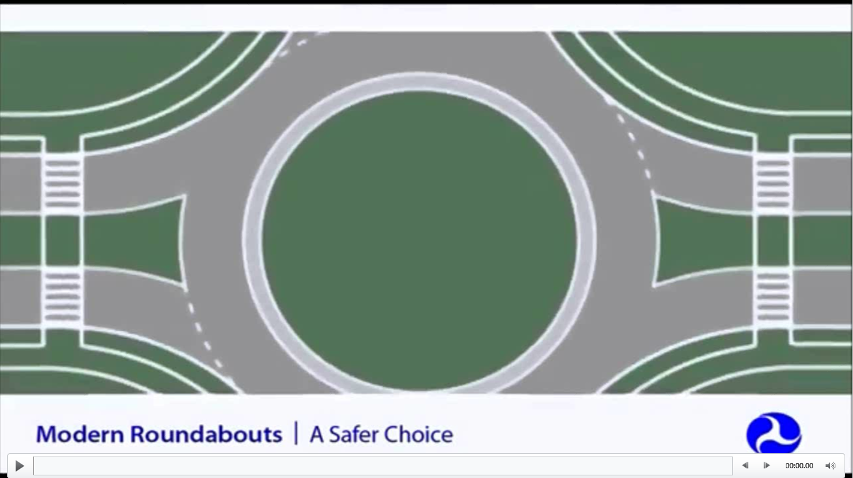
Watch the video!
Notes:
We invite you to watch a video of how roundabouts work in the exhibit viewing area outside.

Slide 19

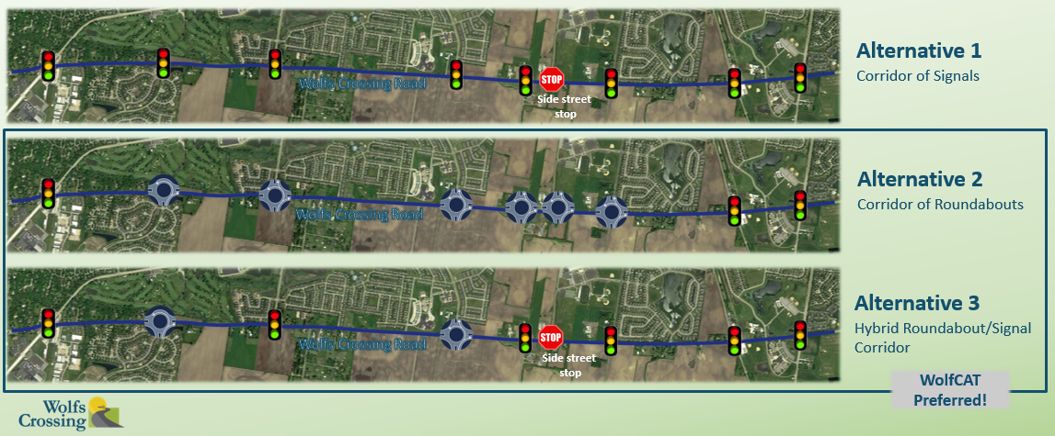
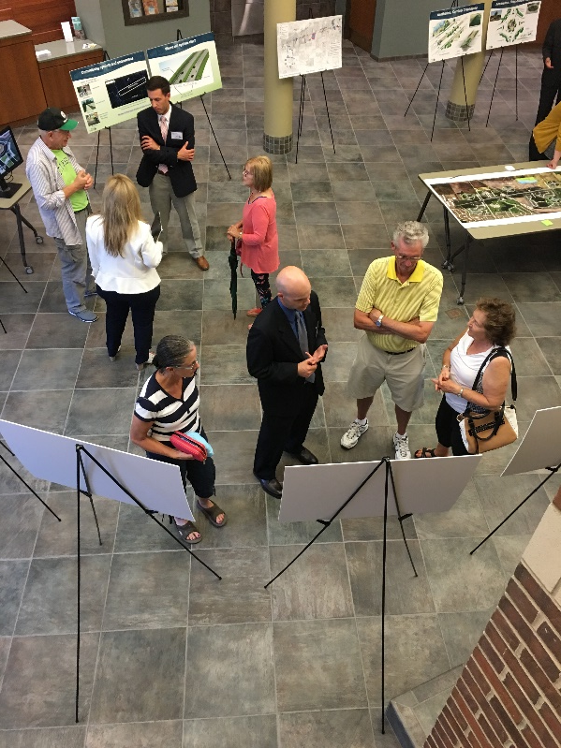
Alternatives
x
✓
✓
June 29, 2017
50 attendees
Notes:
Based on all that they learned about intersection functions, the WolfCAT assisted in developing three alternatives. These were presented for consideration by the public at Public Meeting No 2 on June 29, 2017. 50 attendees joined us to learn about these alternatives. Alternative one is a corridor of all traffic signals. Alternatives two and three were a combination of roundabouts and signals.. We asked attendees to submit written comments on their favorite alternative. Surprisingly, we received no votes for the corridor of all signals, telling us that Oswego residents are open to constructing roundabouts on Wolfs Crossing. We received an equal number of votes for alternative 2 and 3.

Slide 20
The Proposed Plan
Notes:
Based on what we learned at public meeting number two and our final WolfCAT’s input, the team has developed the final proposed plan for Wolfs Crossing for your review tonight.

Slide 21
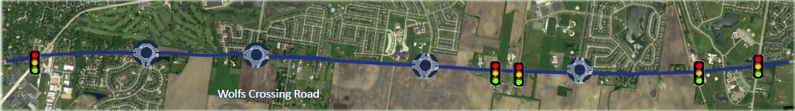
The Recommended Alternative
Southbury
Boulevard
Douglas Rd
North
Fifth
Avenue
Harvey
Road
Roth
Road
Oswego
EHS
Eola/
Heggs
IL34
US30
3 lanes
(one lane in each direction plus turning lane)
5 lanes
(two lanes in each direction plus turning lane)
Notes:
This slide depicts the recommended alternative for Wolfs Crossing. The team studied each intersection to assess whether or not a roundabout could be reasonably built without substantial impacts and if it would perform well in tandem with other intersection control. In looking at the property impacts, environmental and historic property impacts, and the overall operation of multiple roundabouts running in tandem closely on a corridor, it was determined that (click) four of the intersections can be designed as roundabouts. These include Southbury Boulevard, Douglas Road North, 5th Ave. and Harvey Road . The five remaining intersections (click) Illinois 34, Roth Road, Oswego East high school intersection, US30 and Eola Heggs, will be developed and/or remain as traditional traffic signals.
Based on the 2040 traffic projections, the roadway cross section is recommended to be three lanes (one lane in each direction plus a turning lane) from IL 34 to Southbury Boulevard, and Five lanes (two lanes in each direction plus a turning lane) from Southbury to Eola/Heggs.
The main goal of the NEPA process is to develop a preferred alternative that minimizes impacts to the environment. The gentle curve of the roadway alignment provided the Village with a unique tool to not only minimize impacts, but in several locations completely avoid them by shifting the alignment out of the way of the potential impact. For instance, the Roth Road intersection has been shifted to eliminate impacts to the historic church on the northeast corner of the intersection. An exhibit in the viewing gallery illustrates the minimal environmental impacts anticipated on this corridor.

Slide 22
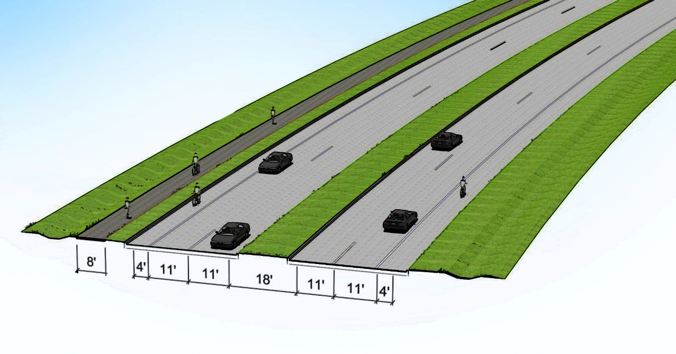

The Roadway Section
Initial roadway section in undeveloped areas
Ultimate roadway section
Graphics being revised to remove bike shoulder
Notes:
This is the 3-dimensional view of what the roadway cross-section would look like. Initially the roadway section in undeveloped areas of the corridor will have two traffic lanes in each direction accompanied by a multi use path on the north side of the road. This can accommodate pedestrians and cyclists and will provide access to the existing developments on the north side of the road. In the ultimate, an additional sidewalk would be added on the south side of the road to accommodate future developments on the south side of the roadway corridor.

Slide 23
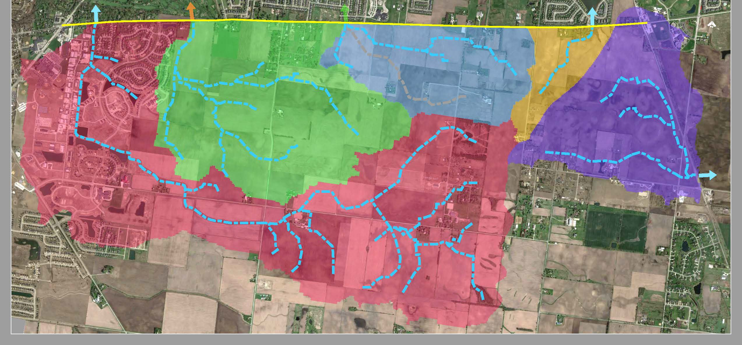
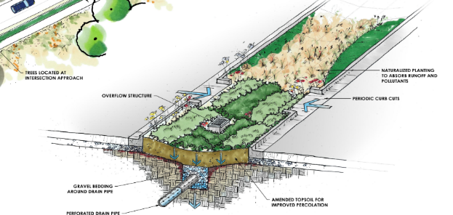
Drainage
WOLFS CROSSING ROAD
DA4
DA3
DA2
DA5
Median bio-swale
DA1
Historical flooding or overtopping
3,700 acres
Proposed detention location
Notes:
Drainage is a major consideration on this project. The yellow line at the top of this map depicts wolfs crossing. (click) The five colored areas on this map labeled drainage areas (DA) one through five, graphically represent the watersheds that all drain to the road, and then continue to drain across the roadway, ultimately discharging to the Fox River. (click) In all, over 3700 acres of land drains to Wolfs Crossing. This is a significant drainage area, and it is important to understand how this series of watersheds work to ensure that the improvements leave the discharges in as good or better function than they are today. (Click) there are some known flooding problems on the corridor already. The pink ovals show areas of known ponding and flooding as well as locations where stormwater has overtopped the pavement in the past. The study team has several plans to manage this flow. (Click) These include a series of small detention ponds (not shown to scale) located throughout the corridor to store stormwater, allowing it to release through the discharge pipes under the roadway at a controlled rate. The discharge pipes under the roadway will be upsized and rehabilitated. Median bio swales will be built in the roadway center to create naturalized underdrains and infiltration basins. Finally a system of traditional storm sewer and shallow ditches will serve to create an entire drainage system to manage the stormwater on this corridor.

Slide 24
When will we build it?
Notes:
So what is the Village’s plan to build this project?

Slide 25
The Wolfs Crossing Project
EOLA RD
PRESCOTT
MILL
5
OSWEGO EAST
HIGH SCHOOL
4
CHURCHILL ELEMENTARY
& PLANK JRHS
1
WOLFS CROSSING ELEMENTARY
& BEDNARCIK JRHS
DOUGLAS RD
CHURCHILL
CLUB
2
7
6
8
3
WOLFS CROSSING RD
HEGGS RD
ROUTE 34
ROTH RD
HARVEY RD
LINCOLN HIGHWAY (ROUTE 30)
9
10
SOUTHBURY
DOUGLAS RD
ROUTE 71
$60 million +
Notes:
The total expected cost for this project today without escalation is over 60 million dollars. (click) This is obviously a huge tab, and the Village does not have these funds to build the entire project at this time. The good news is that many of these improvements are not yet needed. The village intends to build sections of roadway as the need for the improvements evolve, leveraging federal funds, Village dollars, local developer participation and other funding partners along the corridor.
The village asked the WolfCAT to help prioritize what part of the project the community felt was most needed first. They unanimously agreed that the section along Harvey Road was most in need of cross-section improvements and was suffering the highest level of congestion. In addition this location exhibits the highest level of crashes on local portion of the corridor. Therefore, the first project proposed is the (click) Harvey Road roundabout and the associated legs on either side. The village will also improve the drainage along this section (including detention) to reduce the known flooding that occurs today. The Village has secured 2 1/2 million dollars in federal funding, which they will match with village funds to develop this first project. Construction for this project will begin at the earliest in 2020. This segment will likely be built with one lane in each direction (3 lane section) as the five lane section is not yet warranted based on current traffic and development known at this time. The final decision will be made prior to bid after additional traffic counts and assessment of pending developments.
The project team has identified additional project segments and preliminary priorities. You will recall that projecting traffic growth on the corridor is related to local traffic from developments and regional traffic growth. Therefore, these priorities may change if growth occurs differently than expected. No one has an accurate crystal ball regarding development, so the Village has made their best guess and will monitor traffic and crashes. The good news is that there is a plan in place to be ready to accommodate growth if and when development restarts on Wolfs Crossing. It could realistically take up to 20 years to construct all of these segments, but this plan will make sure that the corridor is built responsibly and consistently rather than in a piecemeal and disjointed manner.
With that said, the priorities as projected based on current congestion, future projections and crash rates, are:
(click) Project 2 – the segment east of Harvey
(click) Project 3 – Douglas north intersection
(click) Project 4 – US 30
(click) Project 5 – Eola Heggs
(click - 4) Projects 6 through 10 would most likely occur in the later years of this horizon, and again as traffic and safety issues present that need.

Slide 26
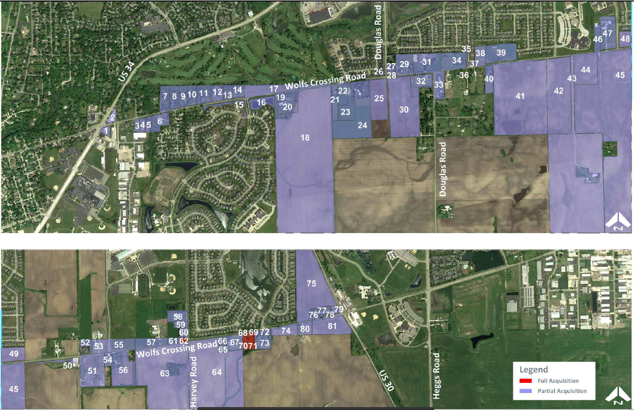
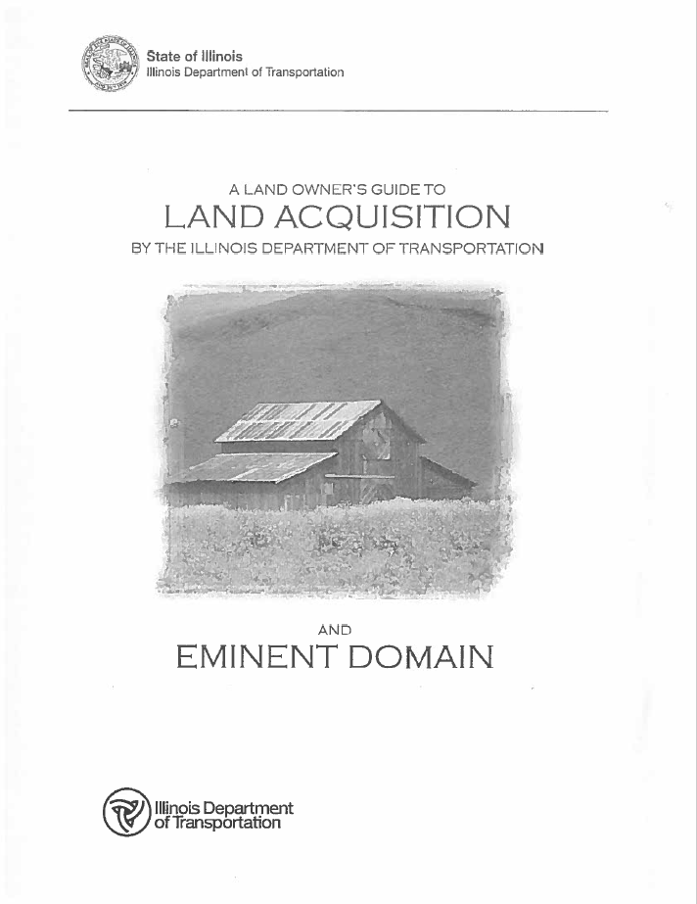
Property required
```
Visit the property acquisition map in the exhibit room after this meeting
Notes:
In order to build the required lanes, medians, parkways and intersections, it will be necessary to acquire additional right of way from the property owners along the corridor. The parcels that are needed to build Wolfs Crossing are shown in purple. (click) For the majority of the parcels, the Village will need to obtain additional strips of property from land owners. This area is highlighted in the red box. In a few instances, the amount of property that will need to be acquired impacts the property to such an extent that it will not be viable. In those cases, it will be necessary for the Village to acquire the entire parcel. (click) There are six total parcels that will need to be acquired in their entirety. We have contacted those individuals prior to this meeting and have notified them of this expectation.
Parcels that will be needed will be acquired as funds become available and the roadway widening demand arises. In some cases, it could be up to 20 years before the additional property is needed for right of way purposes.
Property acquisition will be performed in accordance with federal land acquisition procedures. Brochures are available in the viewing hall regarding the federal process. In general, an appraisal for fair market value for the cost of the parcel or parcel strip. A review appraisal by an independent appraiser is prepared to provide a second opinion on the value.
(Click) In the viewing area, please review the map to see the properties we intend to acquire. (Click) There are also brochures explaining the federal land acquisition process.

Slide 27
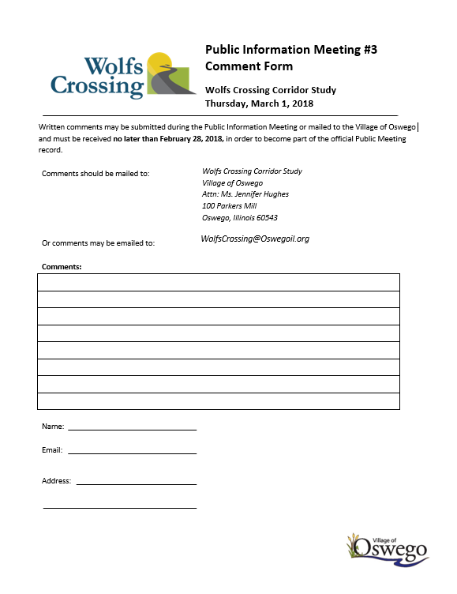
Thanks for attending!
Comments Must Be Received By March 1, 2018
Village of Oswego
Attn: Jennifer Hughes, PE
100 Parkers Mill
Oswego, IL 60543
JHughes@oswegoil.org
(included on comment cards)
Notes:
At the conclusion of this presentation, (click) please proceed to the exhibit area. There you will find a series of exhibits to view and discuss with the project team.
It is important to note that if you want your comments to be part of the formal public record for this project, they must be in written form, either by writing them yourself or emailing them wolfscrossing@oswegoil.org. You will find comment forms for your use throughout the exhibit area. You can fill these forms out and submit them today, or take them with you and return them to the Village’s Project Manager Jennifer Hughes. The official public comment period for this project ends March 1, 2018.
However you choose to send us your comments, your input is valuable.
(click) It has been our continued commitment throughout this project to inform the public and study stakeholders in this process, and we appreciate your input. This presentation, as well as the materials provided and additional comment forms are available on our website at www.oswegil.org.
Please proceed to the exhibit area to meet our team.

